Slide 1
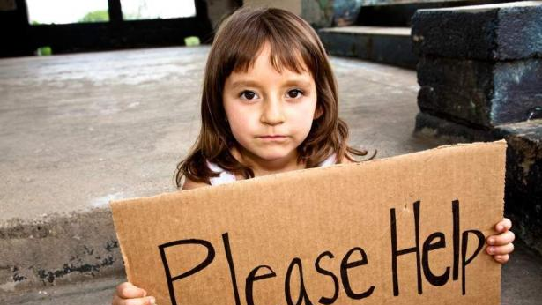
Child Poverty Action Lab
Family Sub Index
Group 4&9

Slide 2
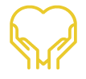


Child Poverty is a Moral Issue
Child Poverty is an Economic Issue
Child Poverty is a
Dallas Issue
For children to grow up with so little in a region where affluence is so visible challenges our most basic principles of fairness.
Poverty exposes children to devastating levels of trauma that undermine a child’s future by stunting physical, cognitive, and behavioural development, thereby producing a lifetime of health and economic challenges.
Economists estimate that childhood poverty costs the U.S. economy over $1 trillion per year, or 5.4% GDP.
Each child growing up in poverty has an average net-cost to our economy of $1.6 million throughout that child’s life.
The cost of inaction is much higher than the cost of action. Every $1 spent to fight child poverty lowers future costs by $7.
Dallas has the 3rd highest rate of child poverty in the nation.
The long-term economic cost of the 95,000+ local children growing up in poverty today exceeds $150 billion.
Over the past 15 years, the poverty rate in Dallas has increased by 42%, while the population has only increased 4.4%.

Slide 3
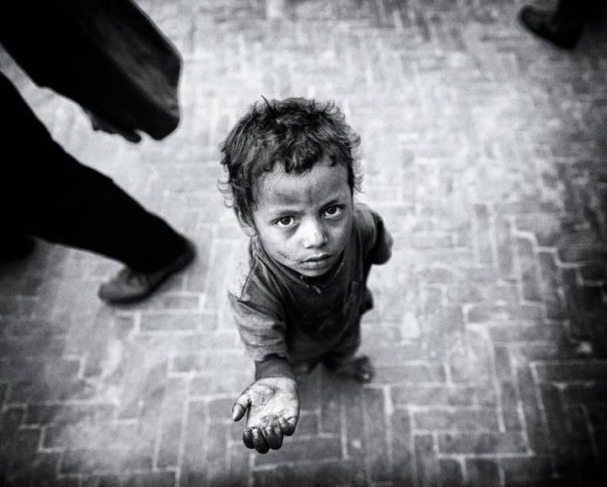
PROJECT OBJECTIVES
This project aims at identifying indicators that would represent the level to which family plays a role in child poverty in a given census tract. We aim at creating a score for all census tracts in Dallas. This score would tell us how well the census tract is doing in terms of family.

Slide 4
Indicators Used
Given below are the list of indicators that we have used in the project
Orphan Child
Average Family Size
Poor Child
Number of House Owners
Disability
Two Parent Households
Single Mother Households
Single Father Households
Number of educated people
Average Income Level
Poverty
Education

Slide 5
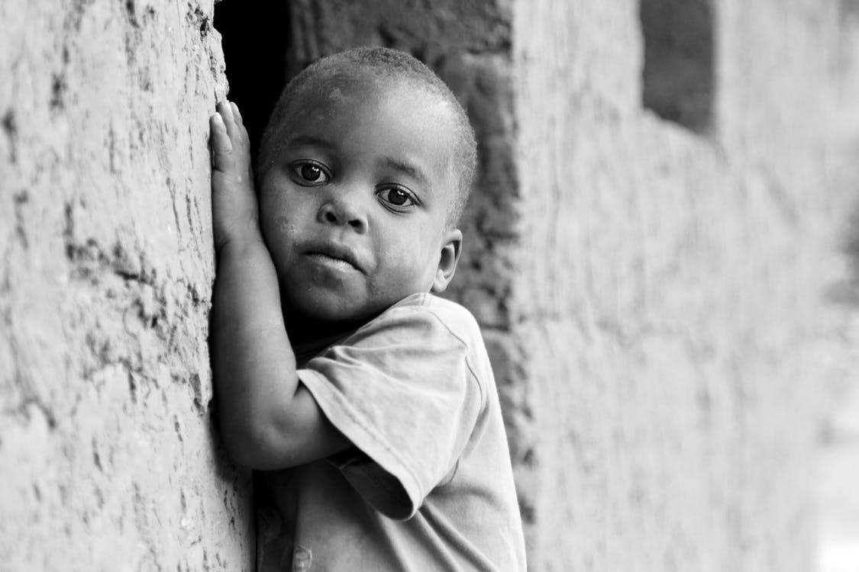
Orphan Child & Poor Child
Reasons for choosing
The status of adults in a family can influence the future status of children, both directly (e.g., adults creating social and economic networks that connects youth to better lifestyle opportunities), and indirectly (e.g., adult’s conditions and attitudes can shape or reinforce child’s aspirations and decision-making in future).
We think that if a child is orphaned or if a child doesn’t get proper care during early childhood days, this initial situation of poverty will make the child struggle for basic necessities in life. Due to this reason, we collected data on orphans and poor children as these two indicators could help us identify child poverty.

Slide 6
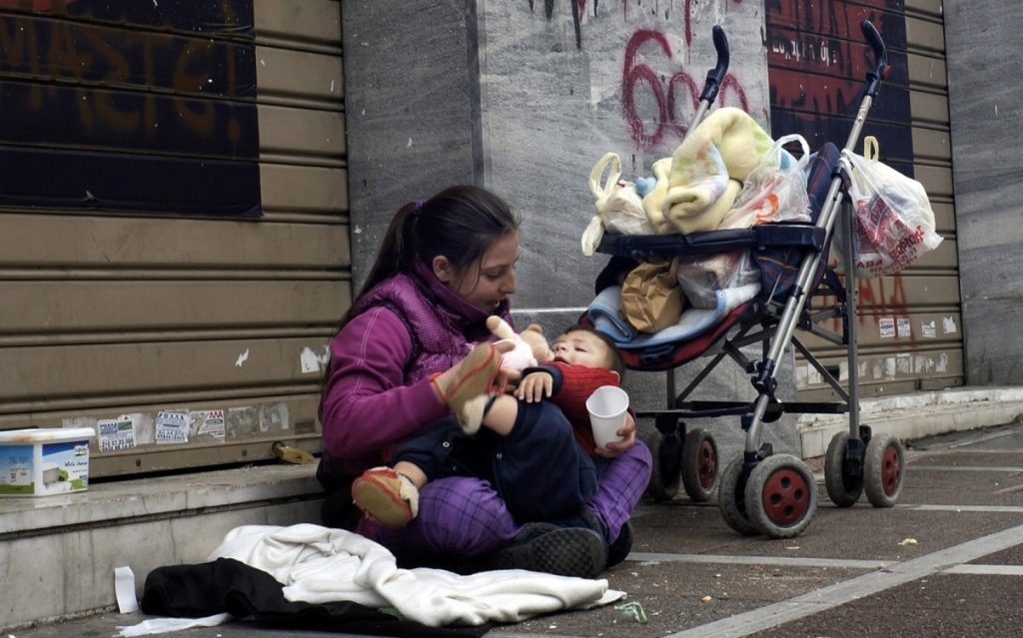
Average Family Size
Reasons for Choosing
When the size of the family grows, so does the difficulty in supporting the family in most cases. A child who is part of a family with 2 adults and 2 children is often at an advantage compared to a child who is part of a family with 2 adults and 6 children. Lesser the number of children, better the attention they get from parents.
For this reason, we thought average family size could be a very good indicator in computing the family index of all the census tracts. It could give us insights about families that are living a quality life and families that are potentially living a low quality life.

Slide 7

Number of House Owners
Reasons for choosing
The status of house ownership in a family can influence the future status of children.
This indicator aims to measure the number of houses in a census tract that are owned versus the number of houses in that census tract that are rented.
We believe that if the parents of the kids own houses, they are in a better position to provide a stable life to their kids in terms of access to resources, education, lifestyle, etc.

Slide 8

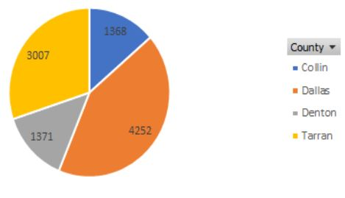
Disability
Reasons for Choosing
According to the U.S Census Bureau, there were nearly 40 million American with disabilities in the US. Disabled Americans earn less than those without a disability. Those with a disability earned a median of $21,572 in 2015, less than 70% of the median earnings for those without a disability ($31,872).
According to the data collected by American Community Survey, there are 9998 kids (under 18 years old) with self- care difficulties in the Dallas area. Dallas County has the largest number, and Collin county has least

Slide 9

Family Type
Reasons for choosing
Family of origin refers to the significant caretakers and siblings that a child grows up with, or the first social group a child belongs to, which is often a child's biological family or an adoptive family. Our early experiences have a major influence on how we see ourselves, others and the world and how we cope and function in our daily living
Based on the above conclusion, we collected the data about the parents marriage status including both parent, single mother and single father.
Since these three indicators are measuring the goodness of one single family environment, we decide to combine these three into one indicator called Family Type to perform dimension reduction.

Slide 10

Education
Reasons for Choosing
The number of adults aged 25 years and older who have completed a Bachelor's degree or higher, for the total population and by race/ethnicity.
This indicator is mainly used for calculating the type score for the family.

Slide 11

Household Income
Reasons for choosing
Household income is indicative of both access to and perceptions of opportunity, and plays a powerful role in shaping individual choices and opportunities for the advancement of children. Neighbourhoods high in economic resources have more financial resources to invest into amenities that depend on local funding, such as schools, parks, and after-school programs.
We think that based on the household income, a child can be provided with access to quality development. If a child doesn’t belong to a household with sufficient income, decisions of life are compromised which could result in low quality living for the child.

Slide 12
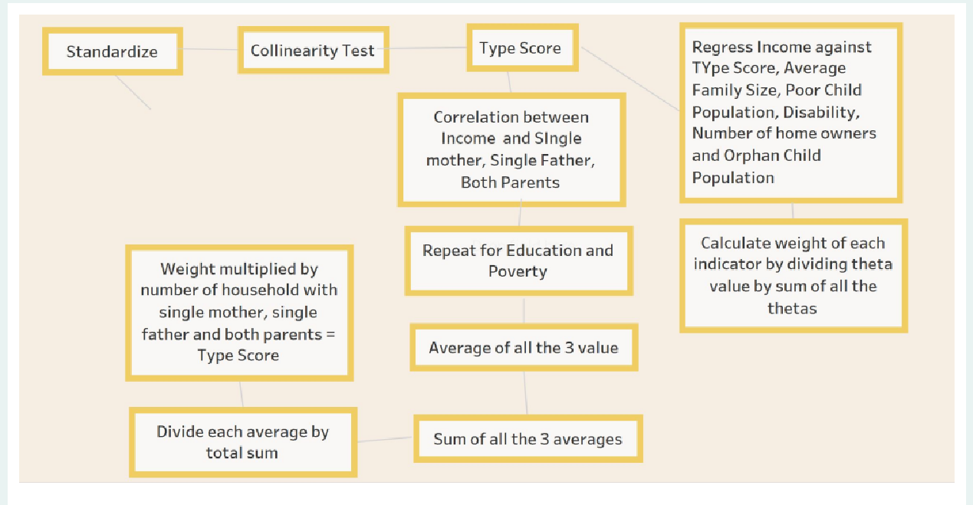
OUR METHODOLOGY

Slide 13
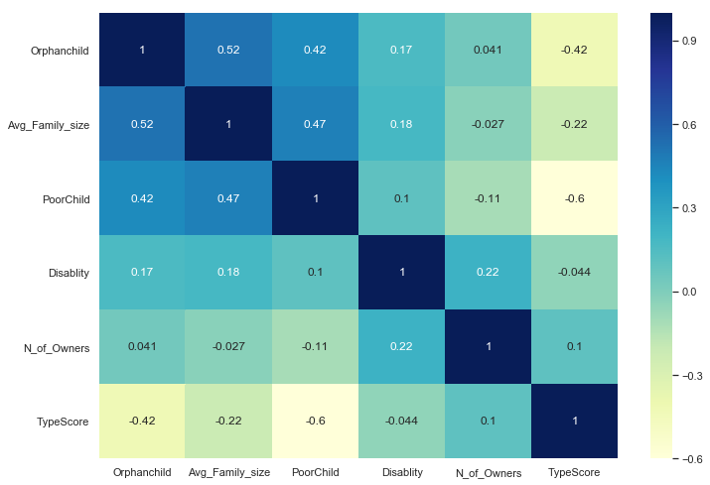
Correlation Heatmap

Slide 14
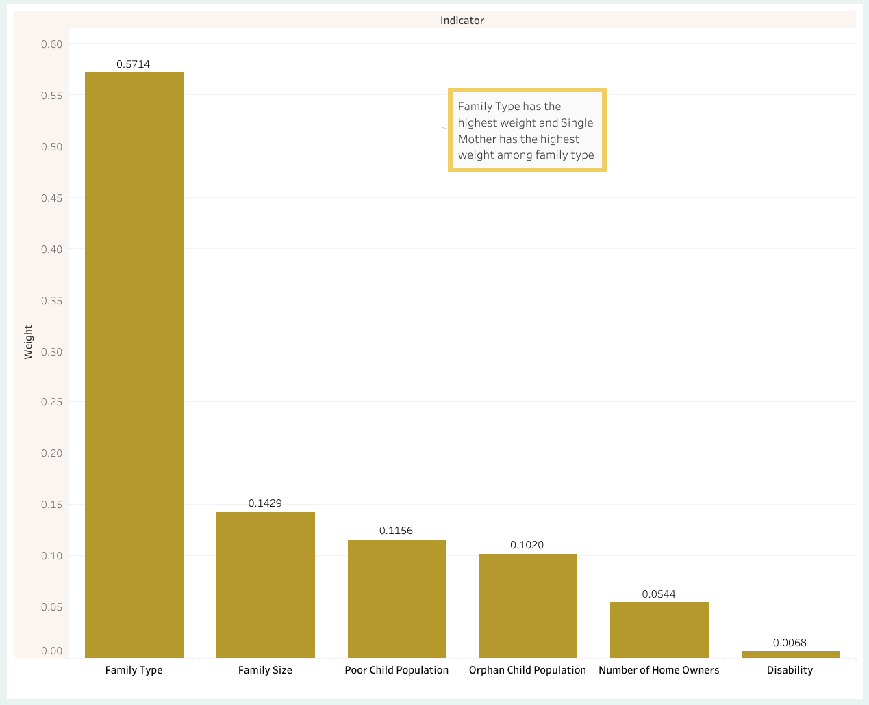

Assigning Weights

Slide 15
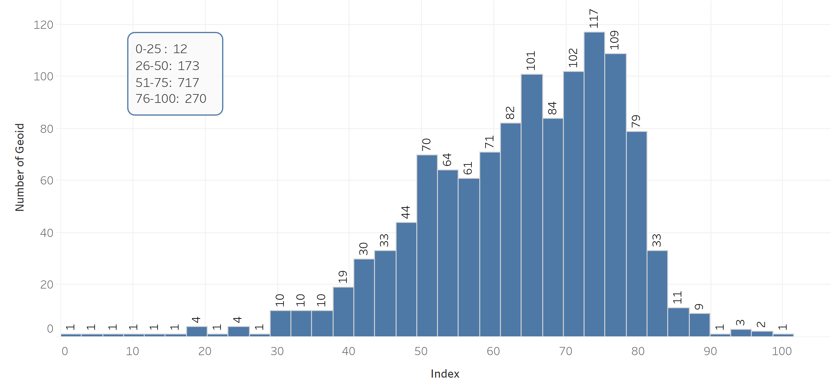
Family Index – At a glance

Slide 16
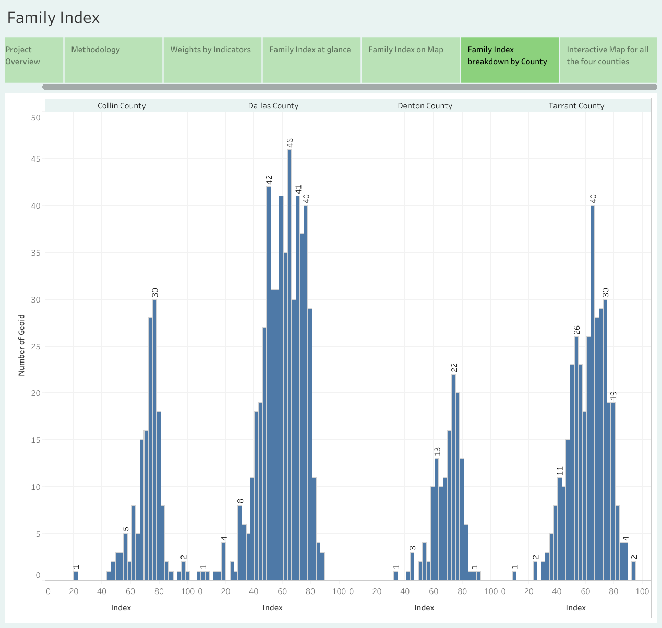
County wise distribution of Family index

Slide 17
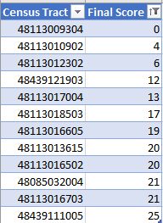
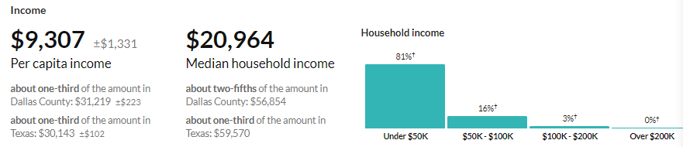
The census tract areas with a family index score lower than 25 are:
Key learning
These areas all have a low income, the Census Tract 93.04,Dallas,TX per capita income is only $9307.

Slide 18
Thank you

